Slide 1
Implementation of the EEHRxF Format: - EEHRxF Overview
Giorgio Cangioli
Technical Lead - HL7 Europe
Hospitals on HL7 FHIR
Lisbon, 10 February 2025

Slide 2
The background
The European Union can only act in those areas where its member countries have authorised it to do so, via the EU treaties.
Few areas where Only EU can legislate (e.g. monetary policy)
Some where EU or national governments can legislate. Member countries can do so only if the EU has not already proposed laws or has decided that it will not. (e.g. justice and fundamental rights)
Other Member countries legislate, EU helps (e.g. health)
Notes:
In areas in which the EU does not have exclusive competence, the principle of subsidiarity seeks to safeguard the ability of the Member States to take decisions and action and authorises intervention by the Union when the objectives of an action cannot be sufficiently achieved by the Member States, but can be better achieved at Union level, ‘by reason of the scale and effects of the proposed action’.

Slide 3


The background
Regulation: a binding legislative act. It must be applied in its entirety across the EU.
Directive: a legislative act that sets out a goal that all EU countries must achieve. However, it is up to the individual countries to devise their own laws on how to reach these goals.
Decision: is binding on those to whom it is addressed (e.g. an EU country or an individual company) and is directly applicable.
Recommendation it is not binding. A recommendation allows the institutions to make their views known and to suggest a line of action without imposing any legal obligation on those to whom it is addressed.
Opinion: is an instrument that allows the institutions to make a statement in a non-binding fashion, in other words without imposing any legal obligation on those to whom it is addressed.
From: https://european-union.europa.eu/institutions-law-budget/law/types-legislation_en

Slide 4
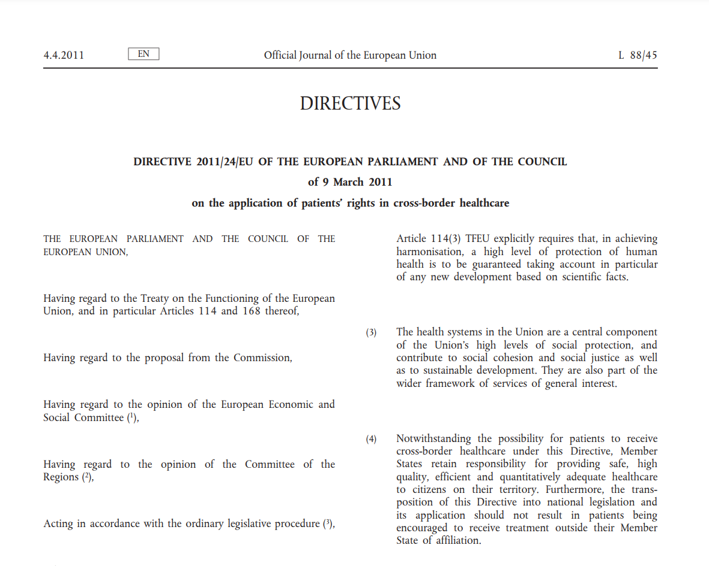




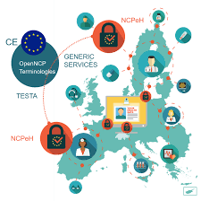

The background
DIRECTIVE 2011/24/EU OF THE EUROPEAN PARLIAMENT AND OF THE COUNCIL of 9 March 2011 on the application of
PATIENTS’ RIGHTS IN CROSS-BORDER HEALTHCARE
ePSOS Project
eHDSI under CEF
Patient Summary
ePrescription

Slide 5

The background
Communication from the Commission to the European Parliament, The Council, the European Economic and Social Committee of the regions on enabling the digital transformation of health and care in the Digital Single Market; empowering citizens and building a healthier society.
Brussels, 25.4.2018
The Communication contains a package of legislative & non-legislative proposals with the aim of supporting Member States action on eHealth to:
1 Access and Sharing of Eletronic Health Records for citizens
2 Connected health data to advance research, prevention and personalised health and care
3 Digital tools to foster citizen empowerment and person-centred care

Slide 6







The background
It sets out a framework for the development of a European electronic health record exchange format in order to achieve secure, interoperable, cross-border access to, and exchange of, electronic health data in the Union.
Ensure that citizens are able to access and securely share their electronic health data across borders
Take measures to ensure that the following health information domains, as a baseline, are part of a European EHR exchange format
6
Notes:
https://digital-strategy.ec.europa.eu/en/library/recommendation-european-electronic-health-record-exchange-format

Slide 7

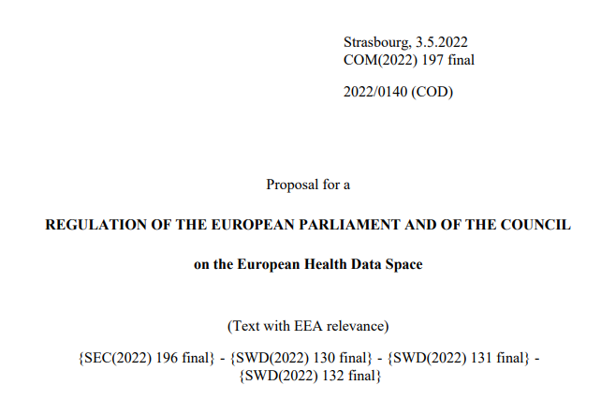
The background
European Commission launched the European Health Data Space (EHDS), one of the central building blocks of a strong European Health Union.
The COVID-19 pandemic has clearly demonstrated the importance of digital services in the health area. The uptake of digital tools increased significantly during this time. However, the complexity of rules, structures and processes across Member States makes it difficult to access and share health data, especially cross-border.
Notes:
Then the COVID arrived …..

Slide 8

MyHealth@EU from the Cross-border Healthcare Directive to the new regulation
Cross-border Healthcare Directive
A voluntary system
Health Data is structured in accordance with eHealth Network guidelines.
14 Member States in operation (6 set to launch).
EHDS
Mandatory participation.
New services introduced
Addition of new data categories.
Derived from a presentation from EC
Slides from EC

Slide 9
EHDS : what is it about?
Let’s start from the Fact Sheet…

Slide 10
EHDS : what is it about?
Primary use = use of data for the delivery of healthcare
Improving patients’ access to their health data;
Ensuring seamless exchanges for continuity of healthcare.
Secondary use = use of data for research and public interest purposes
Making data available for research, policy-making etc. in a safe and secure way.
Requirements for electronic health record (EHR) systems
Creating a single market for electronic health records systems
Slides from EC
Notes:
Advances health data interoperability for healthcare and research
Empowers European Commission to set technical specifications

Slide 11
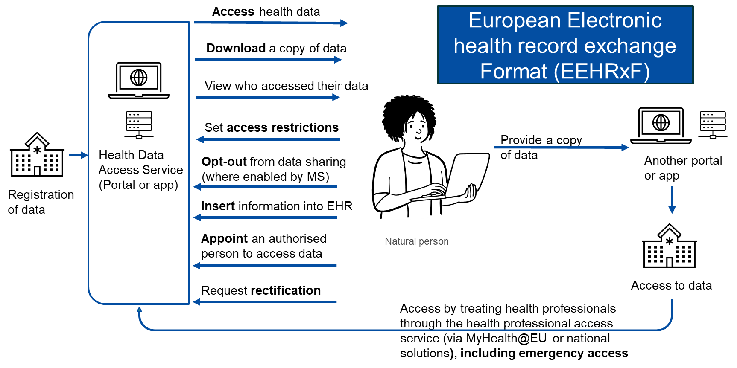
EHDS : what is it about?
Image from EC
Notes:
Rights of natural persons in primary use

Slide 12
EHDS : what is it about?
The EHDS Regulation, published in the Official Journal, is going to enter into force
The EHDS Regulation requires the adoption of the European Electronic Health Record Exchange Format (EEHRxF)
Image from EC
Notes:
Rights of natural persons in primary use

Slide 13
Regulatory implementation of the EHDS
Deadline for main implementing acts
2024
2026
2028
2030
2032
2034
2036
Entry into force
Entry into application
General application
Primary uses of health data (Chapter II)
Exchange of 1st group of priority categories
patient summary, electronic prescriptions and dispensations
Exchange of 2nd group of priority categories
medical images, medical tests results and discharge reports
Only sell compliant products 1st categories
EHR Systems certification (Chapter III)
Only sell compliant products 2nd categories
Secondary uses of health data
(Chapter IV)
Secondary use in general
Selected categories
Genomics, omics, wellness applications
connections
Third countries
Deadline for main implementing acts
Entry into application
Slide from EC
Entry into force

Slide 14
Primary uses of health data – Implementation
Timelines are indicative.
Entry into force
Deadline for main implementing acts
2021
2022
2023
2024
2025
2026
2027
EHDS Regulation
Negotiations
Development of main Implementing acts
Implementing acts
Development of the EEHRxF
X-eHealth
Joint Action Xt-EHR
XpanDH
xShare
Development of MyHealth@EU and patient-facing services (EUDI wallet)
PATHeD
Vaccination Card (EU4Health, EUVAC, tbc)
Patient access through MyHealth@EU (DEP, MyHealth@MyHeands, tbc)
POTENTIAL (EUDI wallet)
Exchange format in healthcare settings (DEP, tbc)
Rollout across MS
Grants for MS implementing MyHealth@EU services
Lab results Guidelines
Implementation Lab results
Medical Images Guidelines
Implementation Medical images
Hospital discharge reports Guidelines
Implementation Hospital discharge reports
Central services of MyHealth@EU (by the Commission)
Compliance Checks
MyHealth@EU Central Services
MyHealth@EU trainings (EU Academy)

Slide 15
Actions related to the European electronic health record exchange format (EEHRxF)
Innovation, experimentation
epSOS, EXPAND, JAseHN, eHAction
X-eHealth
XpanDH
xShare
Further actions
Development of the MyHealth@EU infrastructure
Work on lab results, hospital discharge reports, medical imaging
Defined use cases, data sets, data models
Implementation guides for CDA and FHIR
Further elaboration of the format
Pilots, verification of implementability
Set-up of the ecosystem
Practical implementation of patient-mediated workflow for data portability
Further development of the exchange format (e.g. care plans, telemonitoring)
In-service deployment of the EEHRxF
Patient access to health data using MyHealth@EU
EEHRxF support centre
EUVAC
Formalisation
Work on the eHealth Network guidelines
Work by MyHealth@EU Solution Provider
Joint action Xt-EHR
Implementing Decisions under the upcoming EHDS
Use cases, data sets, principles
Adopted by Member States in the eHN
Implementable specifications, other artefacts
Implementation in OpenNCP for MyHealth@EU
Adopted by Member States in the eHMSEG
Work on the formalisation of the format
Requirements for the certification of EHR systems
(recommendations for possible future implementing acts under EHDS)
Legally binding requirements and specifications for the European health record exchange format
Legally binding requirements for the certification of EHR systems
Infrastructure, deployment
MyHealth@EU current and future services
Patient Summary and ePrescriptions/ eDispensations
Original Clinical Documents
Lab results, hospital discharge reports, medical imaging
Further data categories

Slide 16

Scope of harmonisation
EHR systems must contain two harmonised components, starting 2028/2030 depending on which kind of data they process:
Interoperability component
Logging component
Provides capability to import/ export data in EEHRxF
Provides capability to generate the logs of access
Member States remain free to have requirements on other parts of EHR systems, provided they do not interfere with the harmonised components
Slides from EC

Slide 17
The European EHR eXchange Format
“Such format shall be commonly used, machine-readable and allow transmission of personal electronic health data between different software applications, devices and healthcare providers.
The format should support transmission of structured and unstructured health data.” (art. 15)
EHRxF
Harmonized Dataset
Code Systems & Value Sets
Technical Interop. Specs
Notes:
The format will be formally defined when the Implementation Act will be published

Slide 18
Priority categories <..> for primary use (art. 14)
ePrescription/ eDispensation
Patient summary
Medical test results, including laboratory and other diagnostic results and related reports
Medical imaging studies and related imaging reports;
Discharge report
Member States may provide by virtue of national law that additional categories of personal
The Commission is empowered to adopt delegated acts <…> by adding, modifying or removing the main characteristics of the priority categories

Slide 19




Slide 20

Patient summary
Medical test results, including laboratory and other diagnostic results and related reports
Discharge report
Medical imaging studies and related imaging reports;
ePrescription
eDispensation

Slide 21


The EU HL7 FHIR IGs design strategy
Global Standard
European
Standard
A consistent system (i.e. a federation) of cooperating, coherent and possibly standard-based specifications
“Official”
“The European electronic health
record exchange format could allow for different profiles for its use at the level of EHR systems and at the level of the national contact points for digital health in MyHealth@EU for cross-border data exchange” .
X-Borders
National
Notes:
the settings and contexts in which the format will be utilized are varied and complex, extending beyond just cross-border exchanges. It is difficult to envision a one-size-fits-all solution.

Slide 22
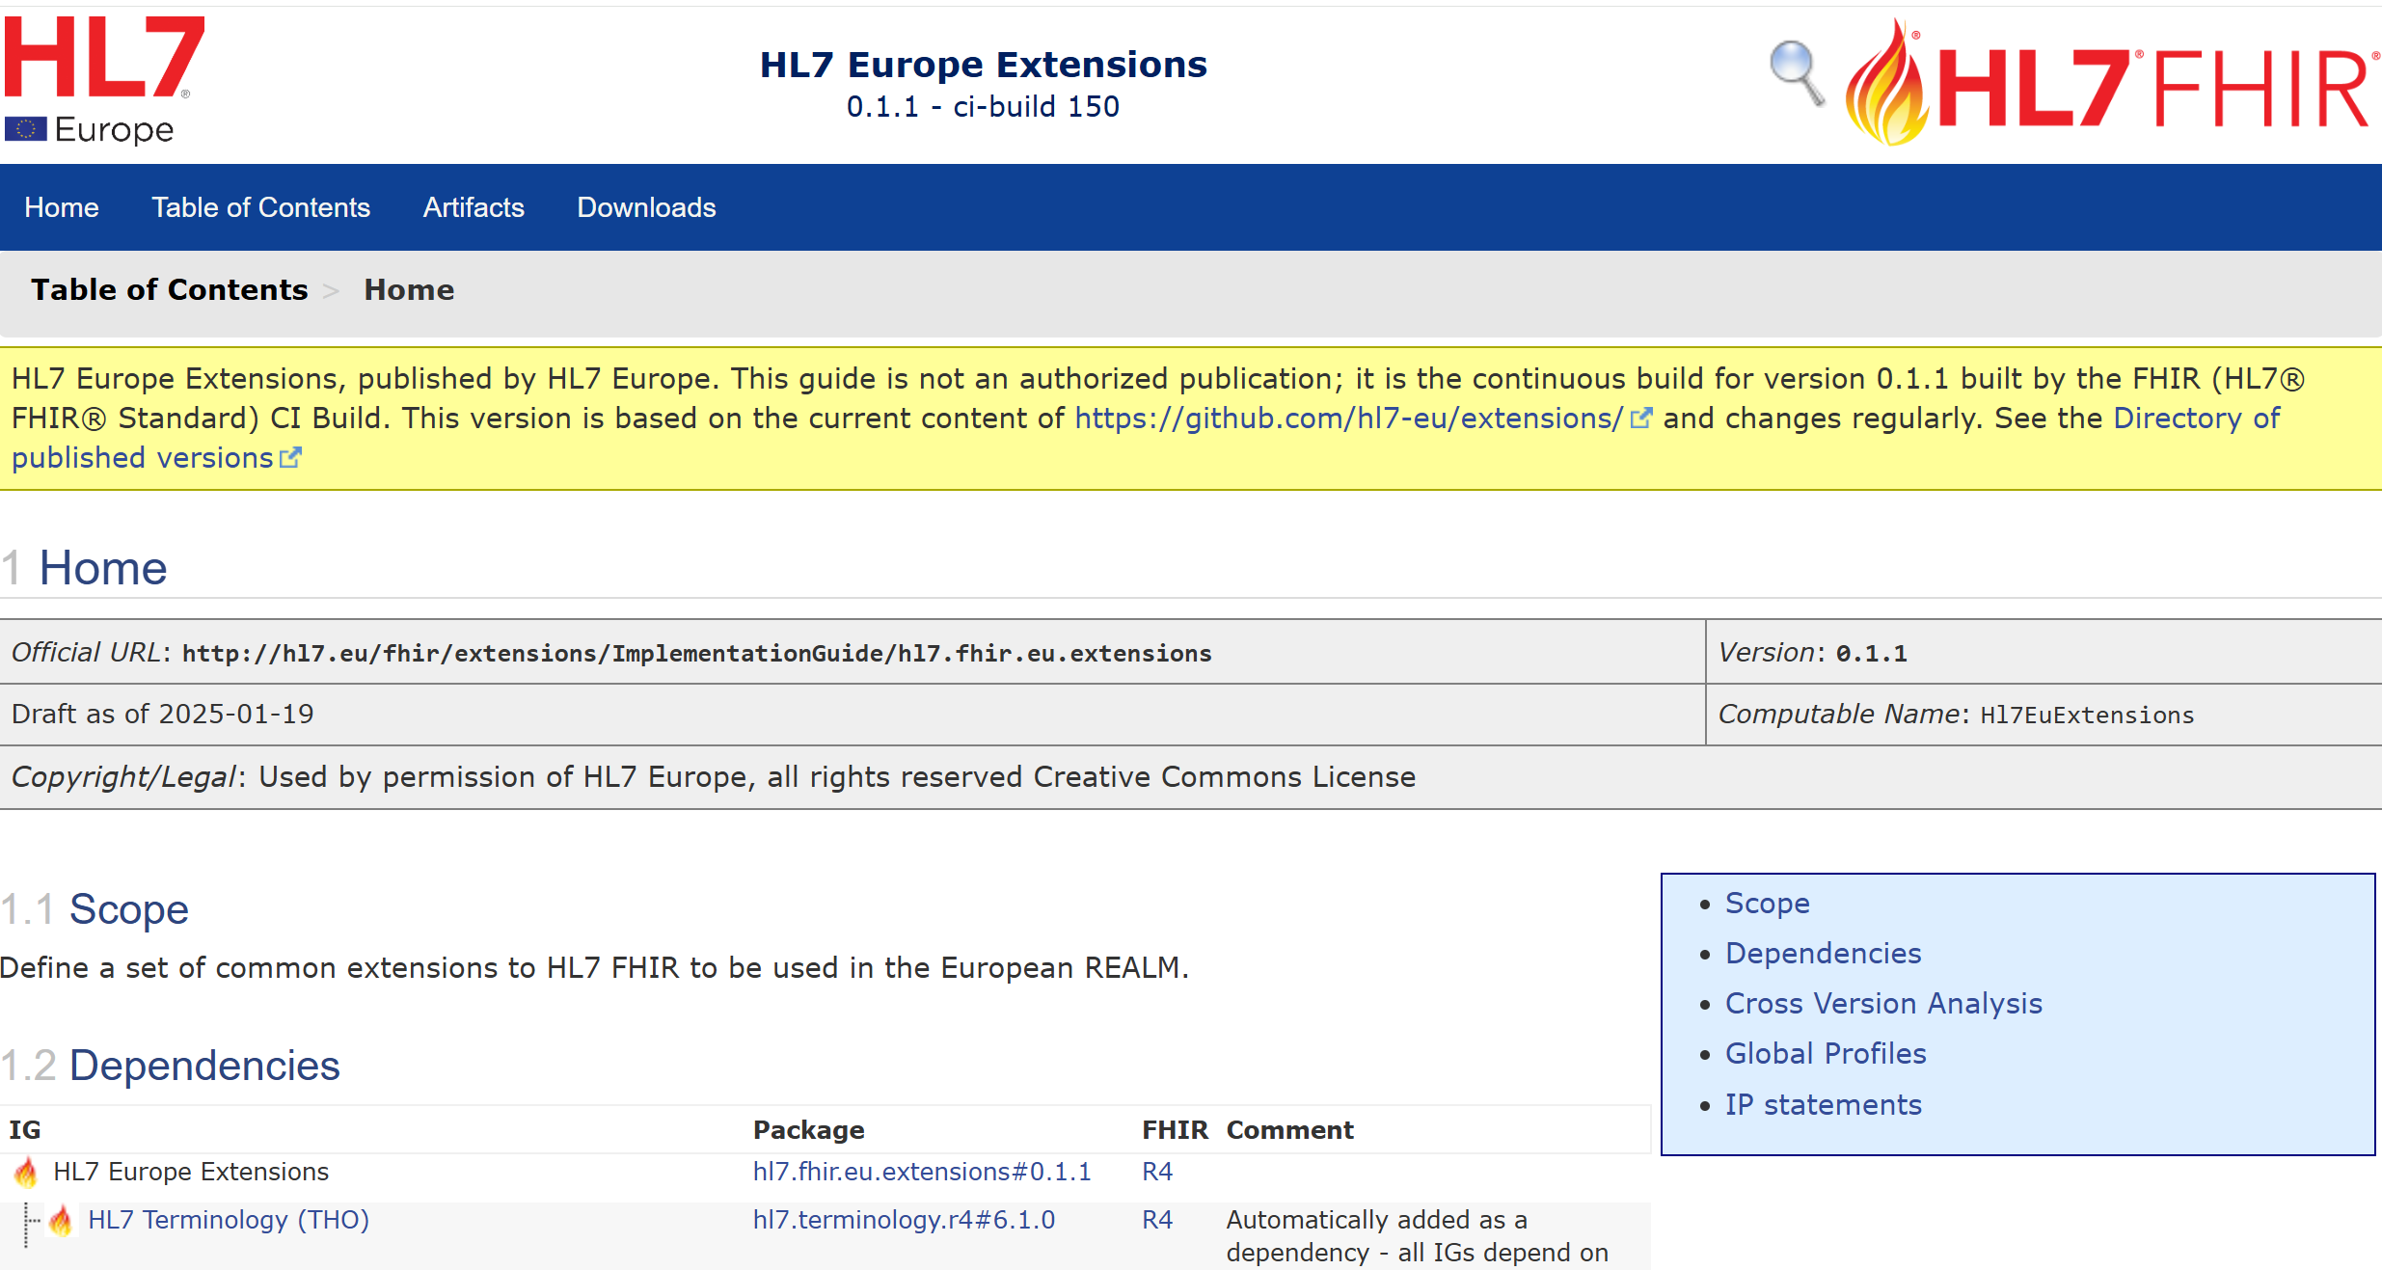

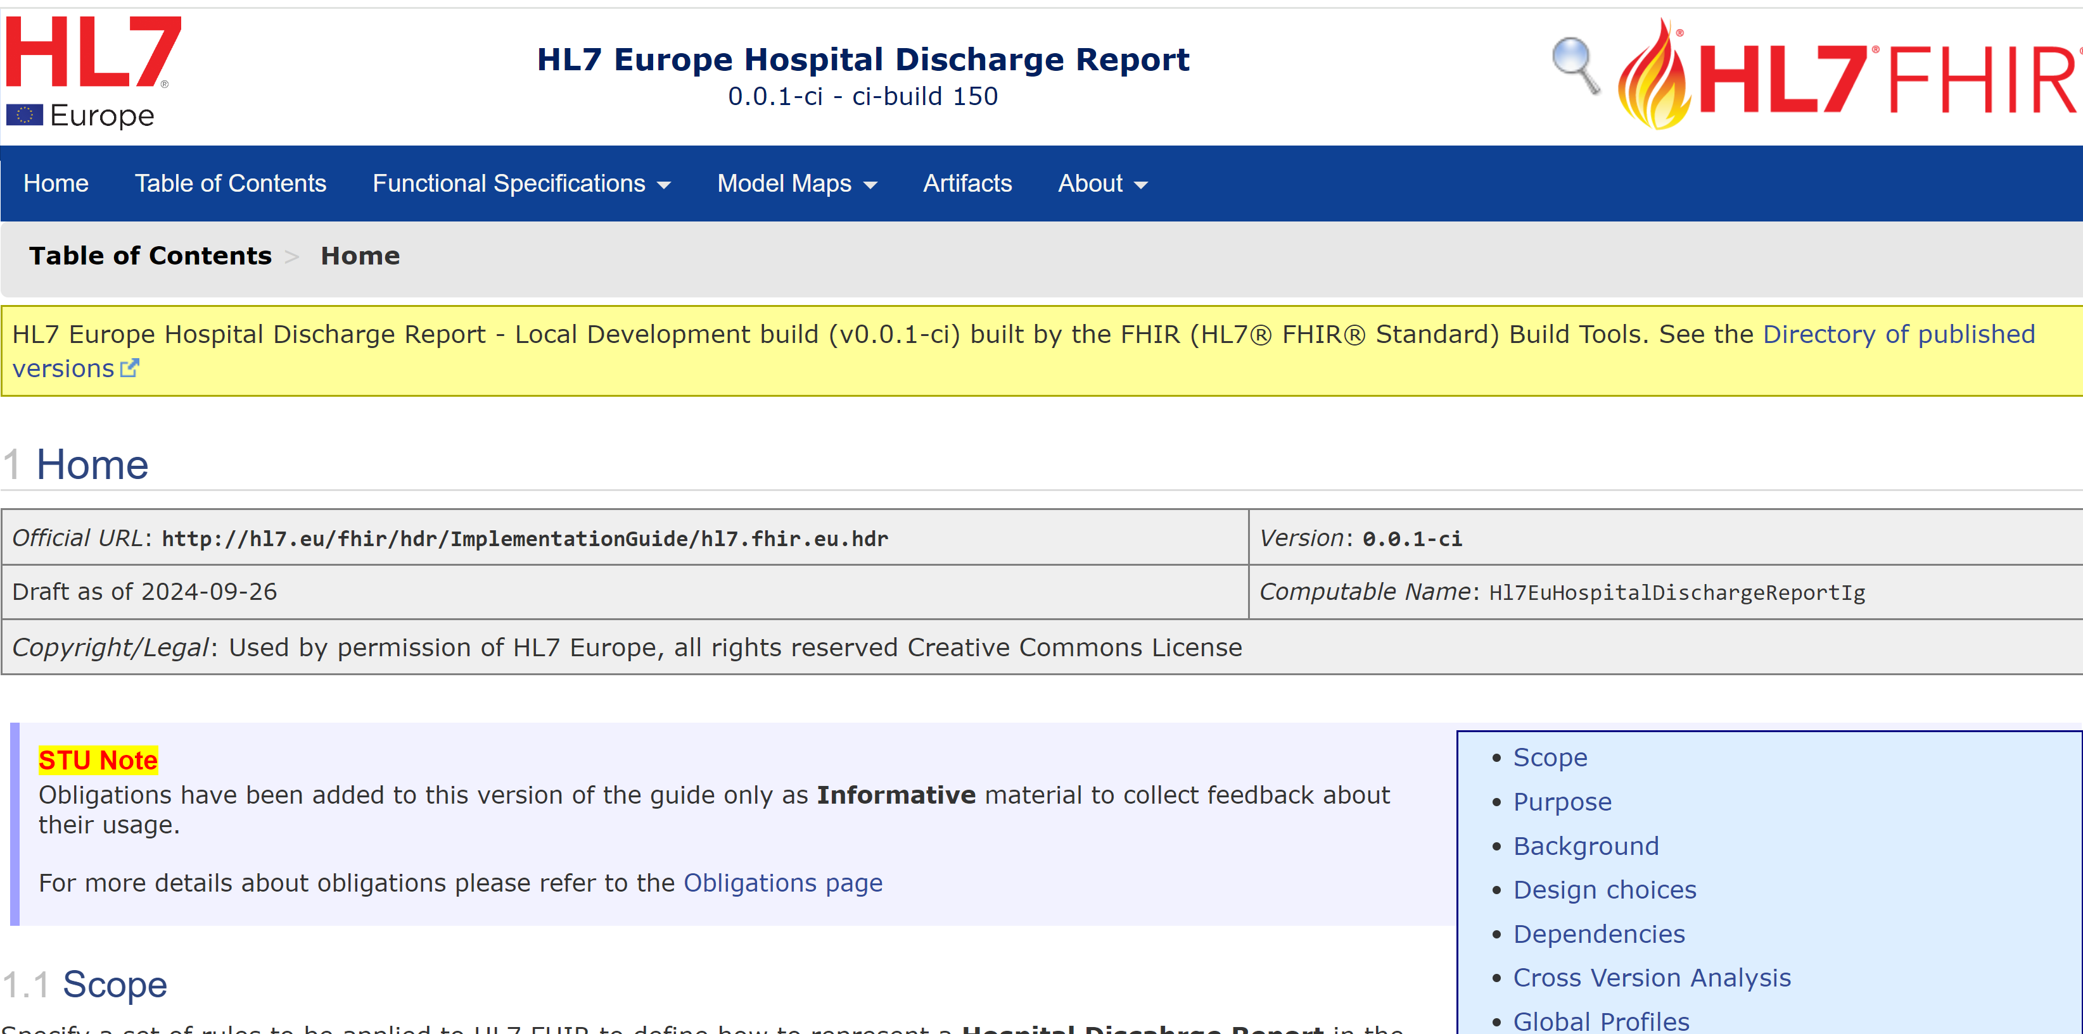
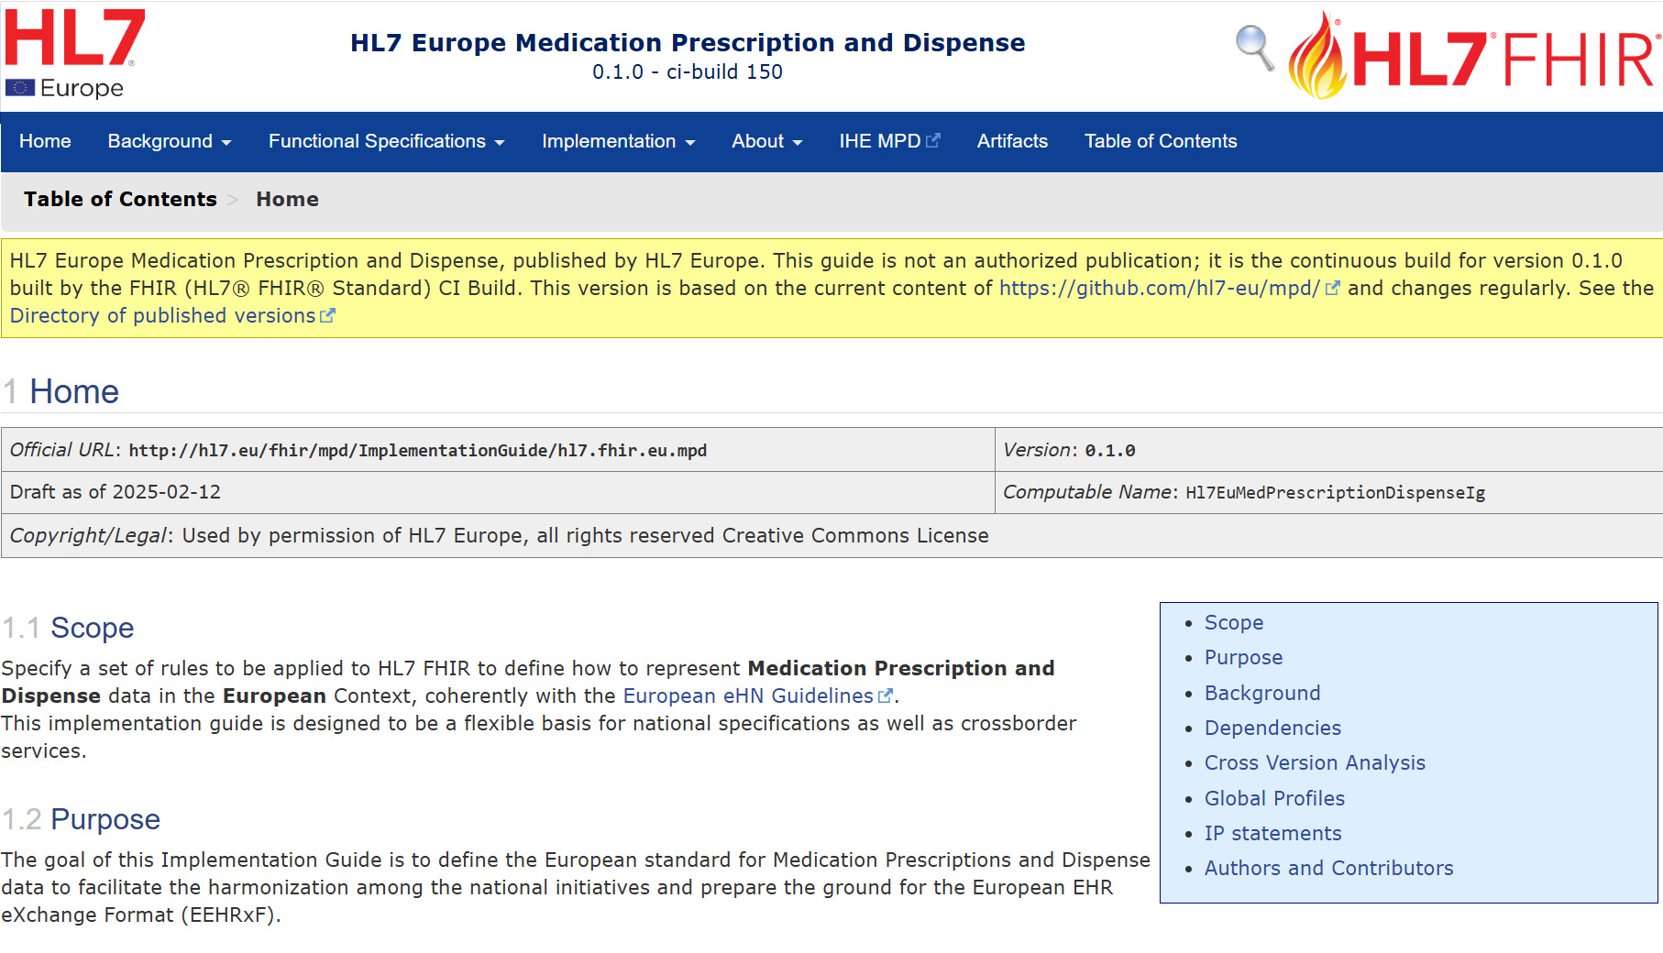
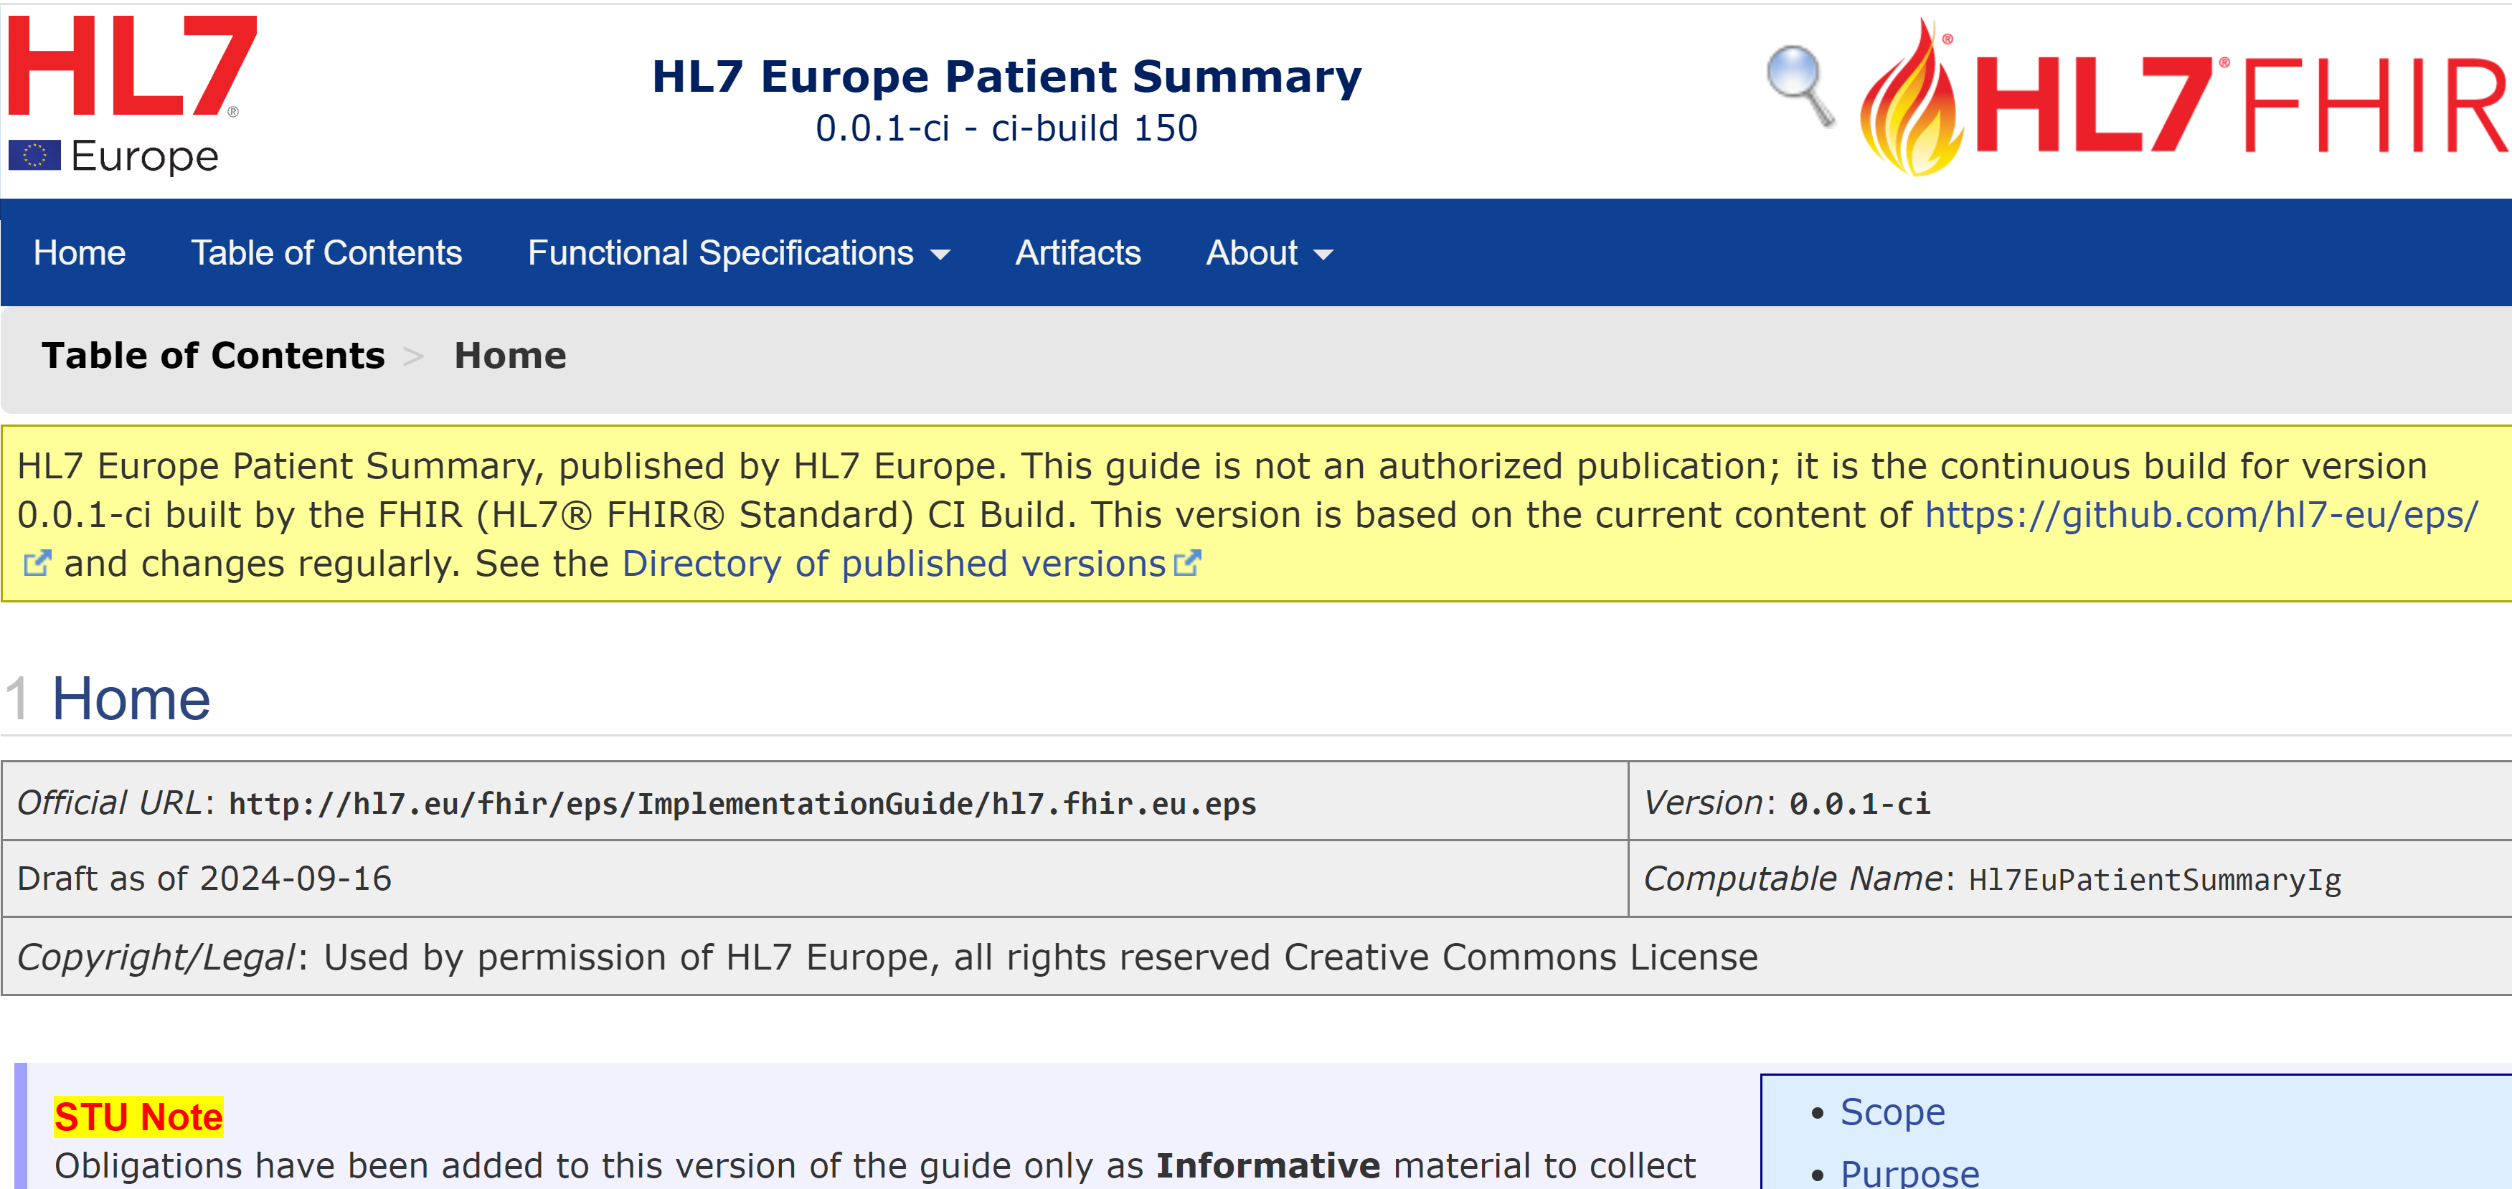
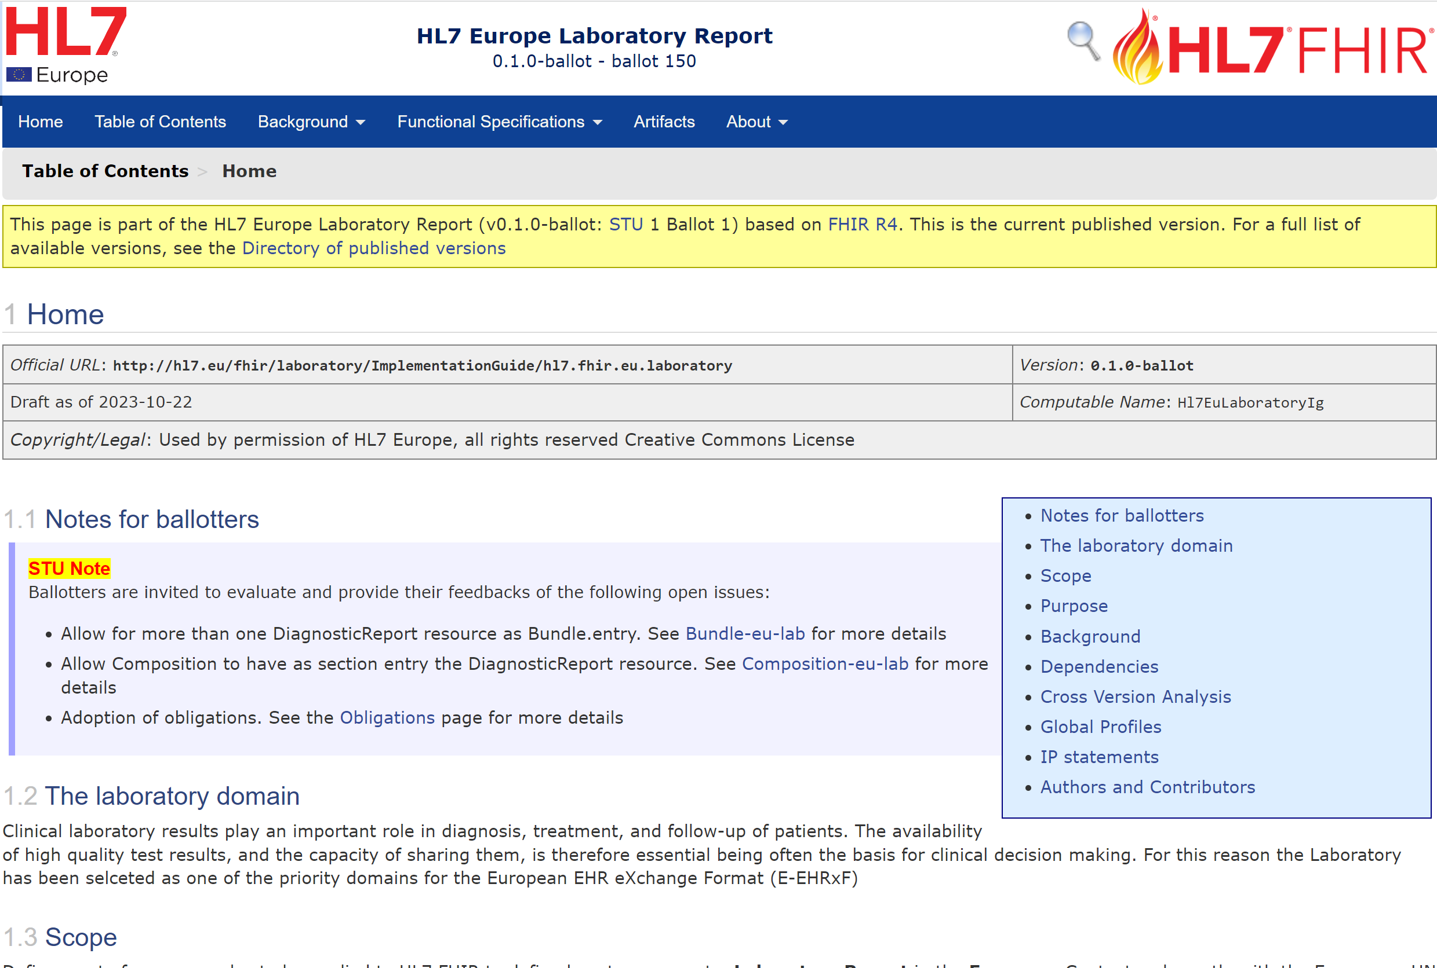


Base/Core Profiles
used by
used by
used by
used by
Hospital Discharge Report
ePrescription
eDispensation
Patient Summary
Laboratory Results
Medical Imaging and reports

Slide 23
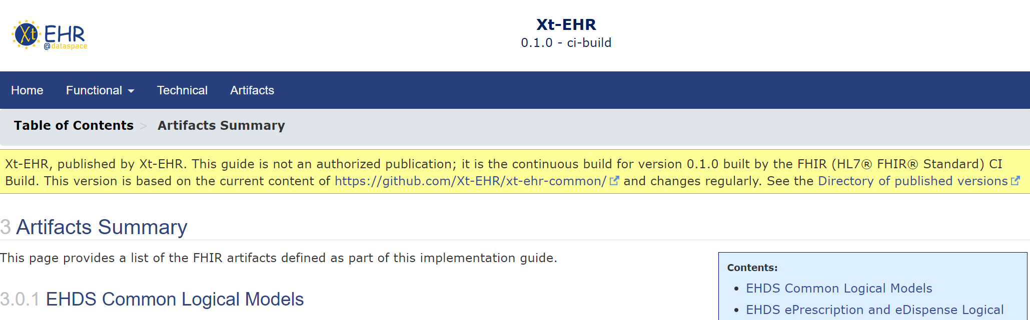
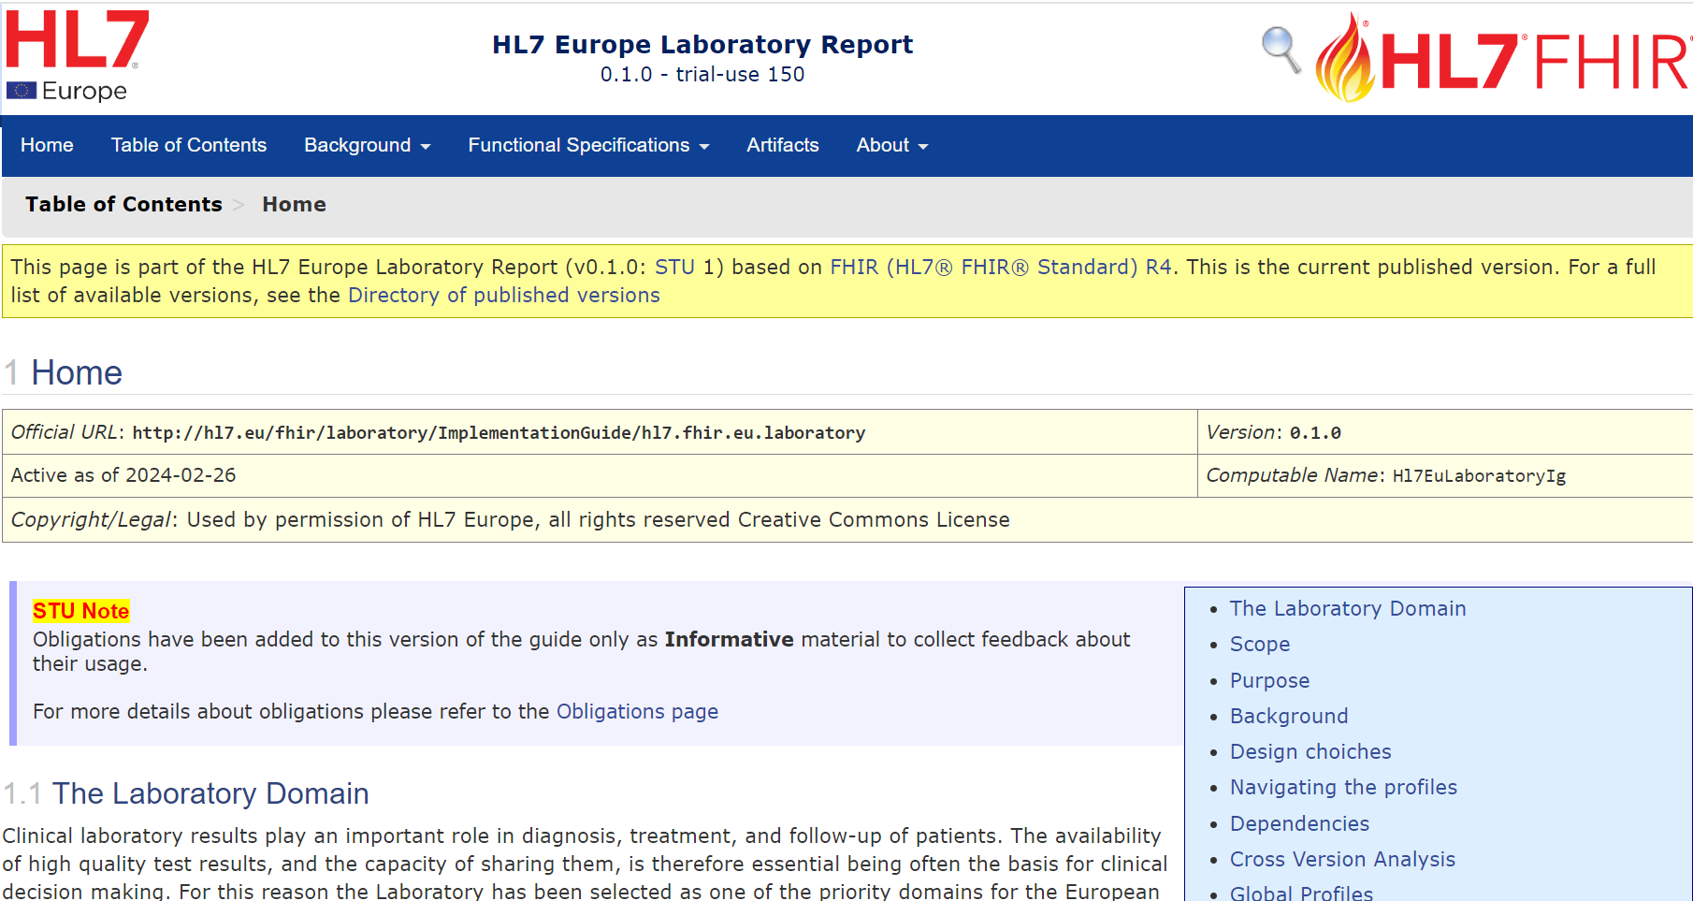
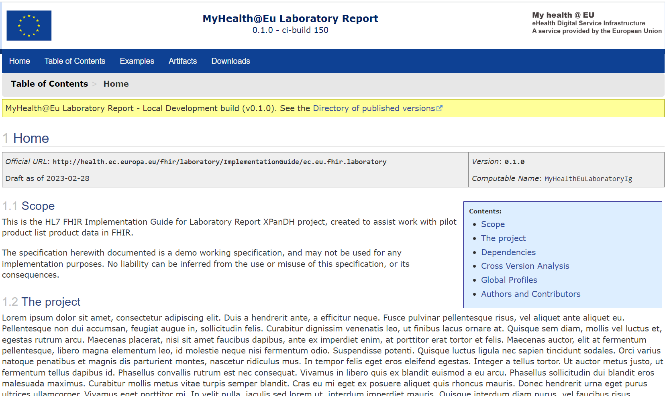
The EEHRxF content
Data set
eHN Guidelines – data sets
Harmonized Dataset
https://health.ec.europa.eu/publications_en
Refined (logical) Model
https://build.fhir.org/ig/Xt-EHR
Code Systems & Value Sets
Value Sets
Technical Interop. Specs
HL7 FHIR IG

Slide 24






HL7 FHIR IGs overview
Global
Standard
European
Standard
European
Official
European
X-border

Slide 25
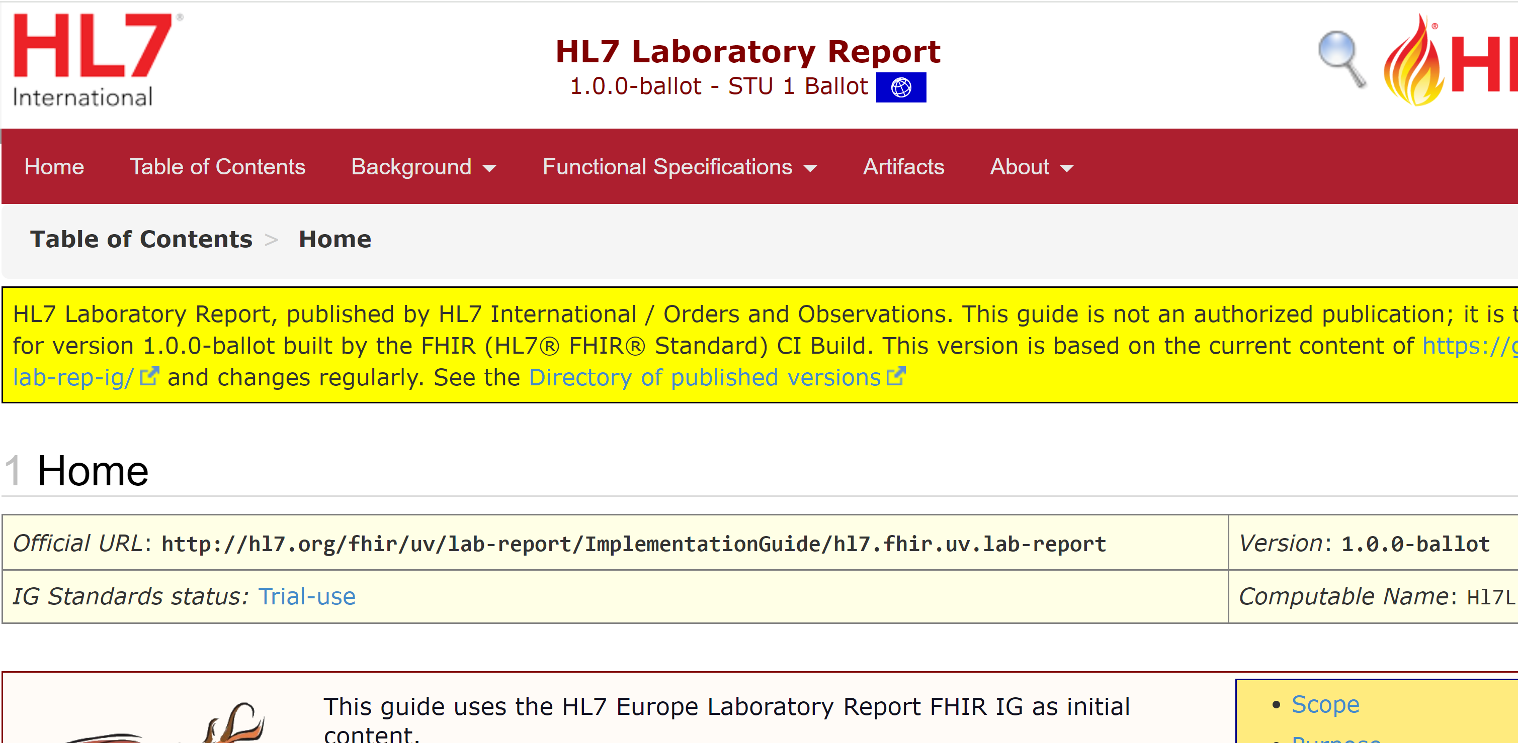

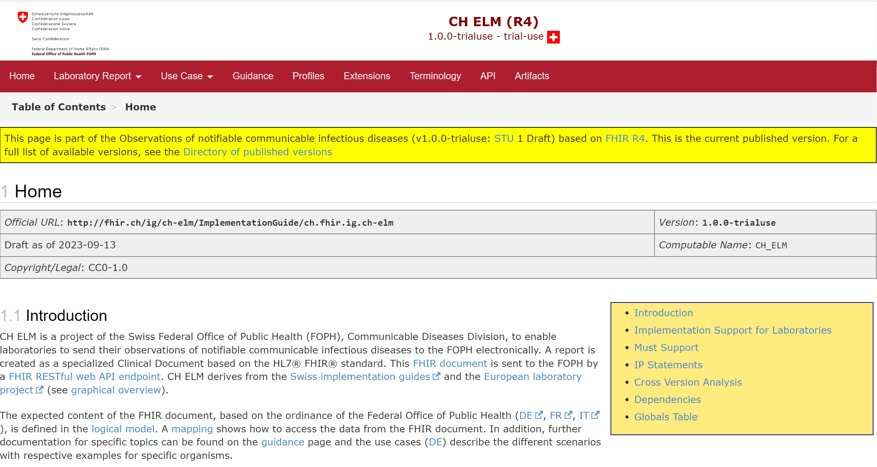
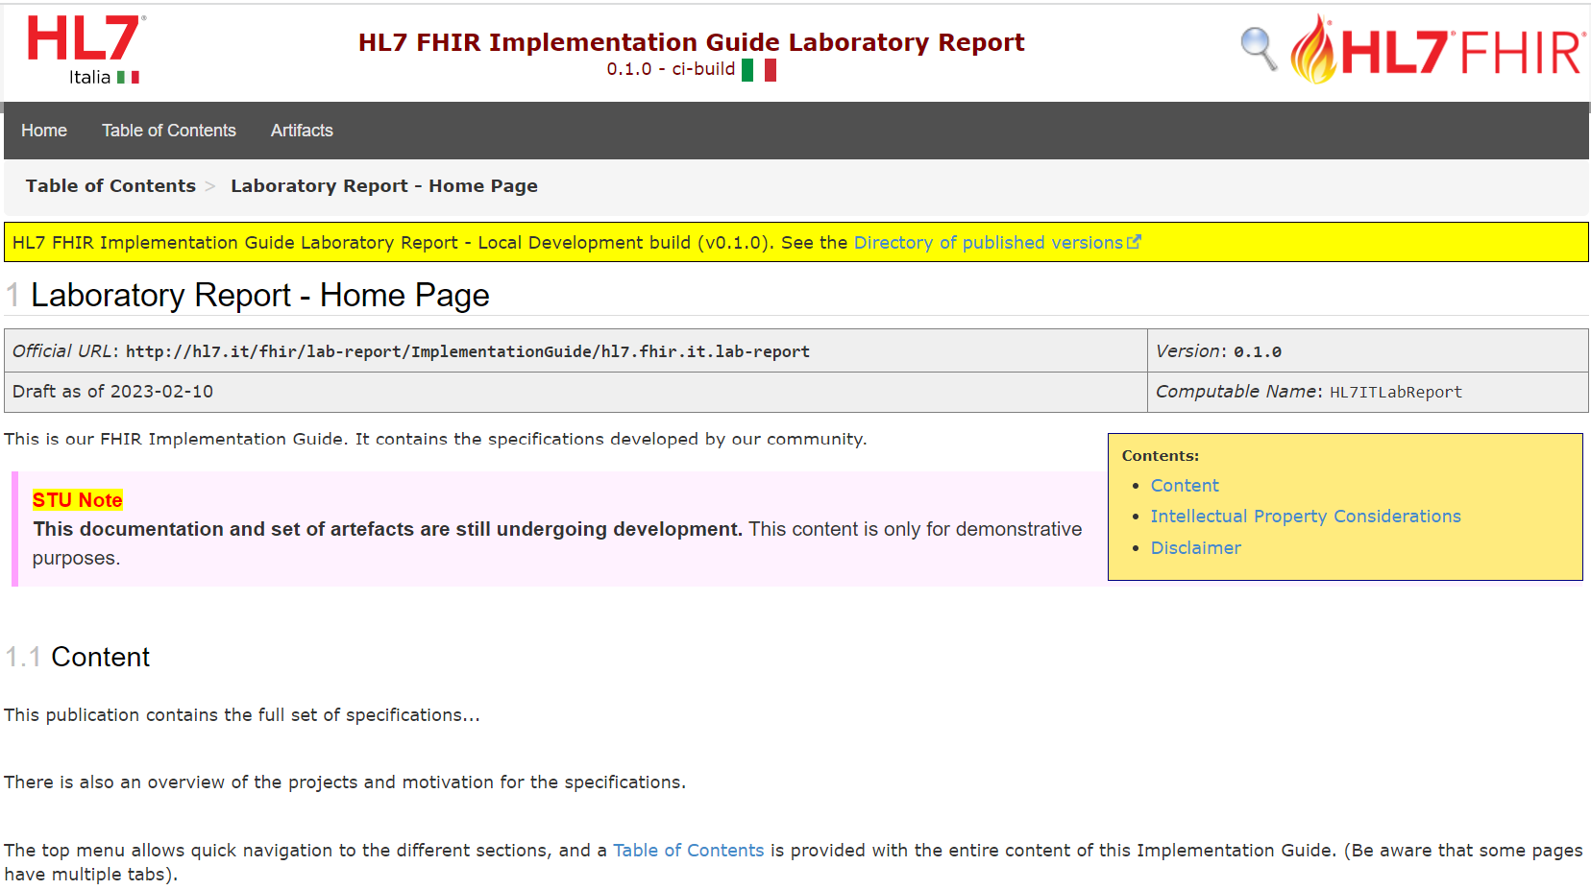
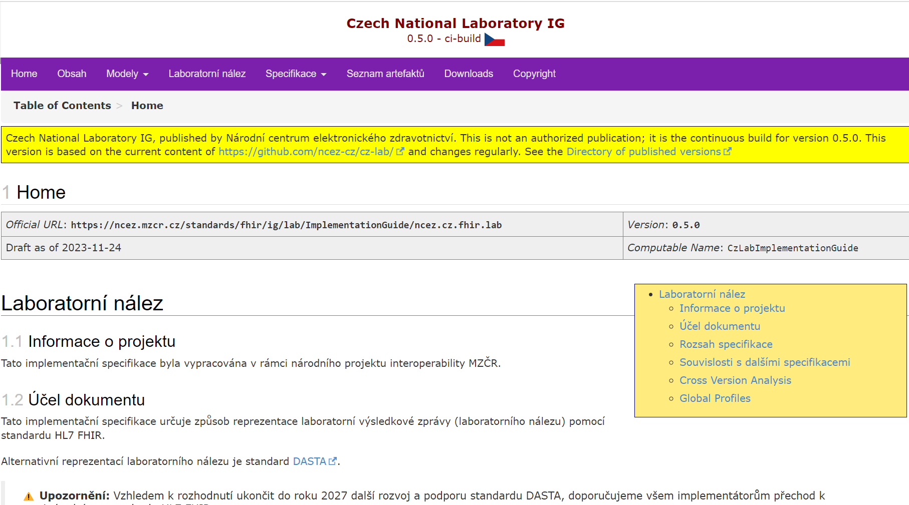

Laboratory Report
R4
Standard
(EU/UV scope)
EU X-Borders
National Guides
Notes:
Following the timeline priority the first in line has been the Laboratory report for which we can assert today that the strategy described has been applied.

Slide 26


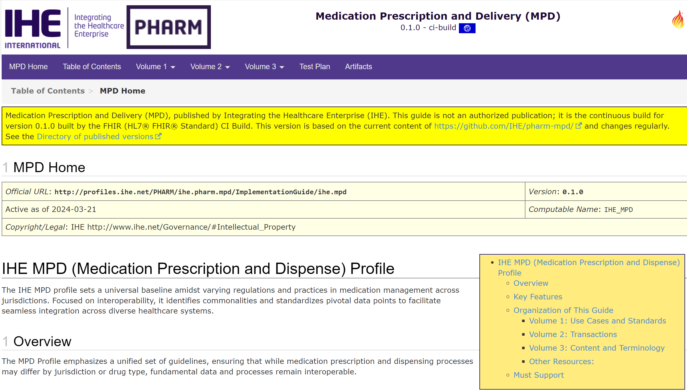



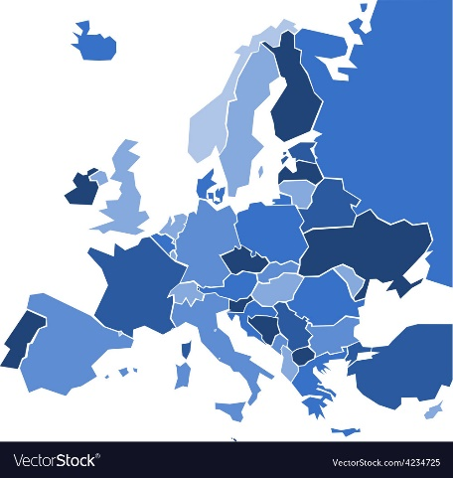

Medication Prescription & Dispense
aligned
derived
R5
R4
Notes:
Developed by a Joint working group (meeting every other Thursday)
In the last meeting of this joint HL7 Europe / IHE Pharmacy meeting there were 40 person; in the first one 35; <…>

Slide 27
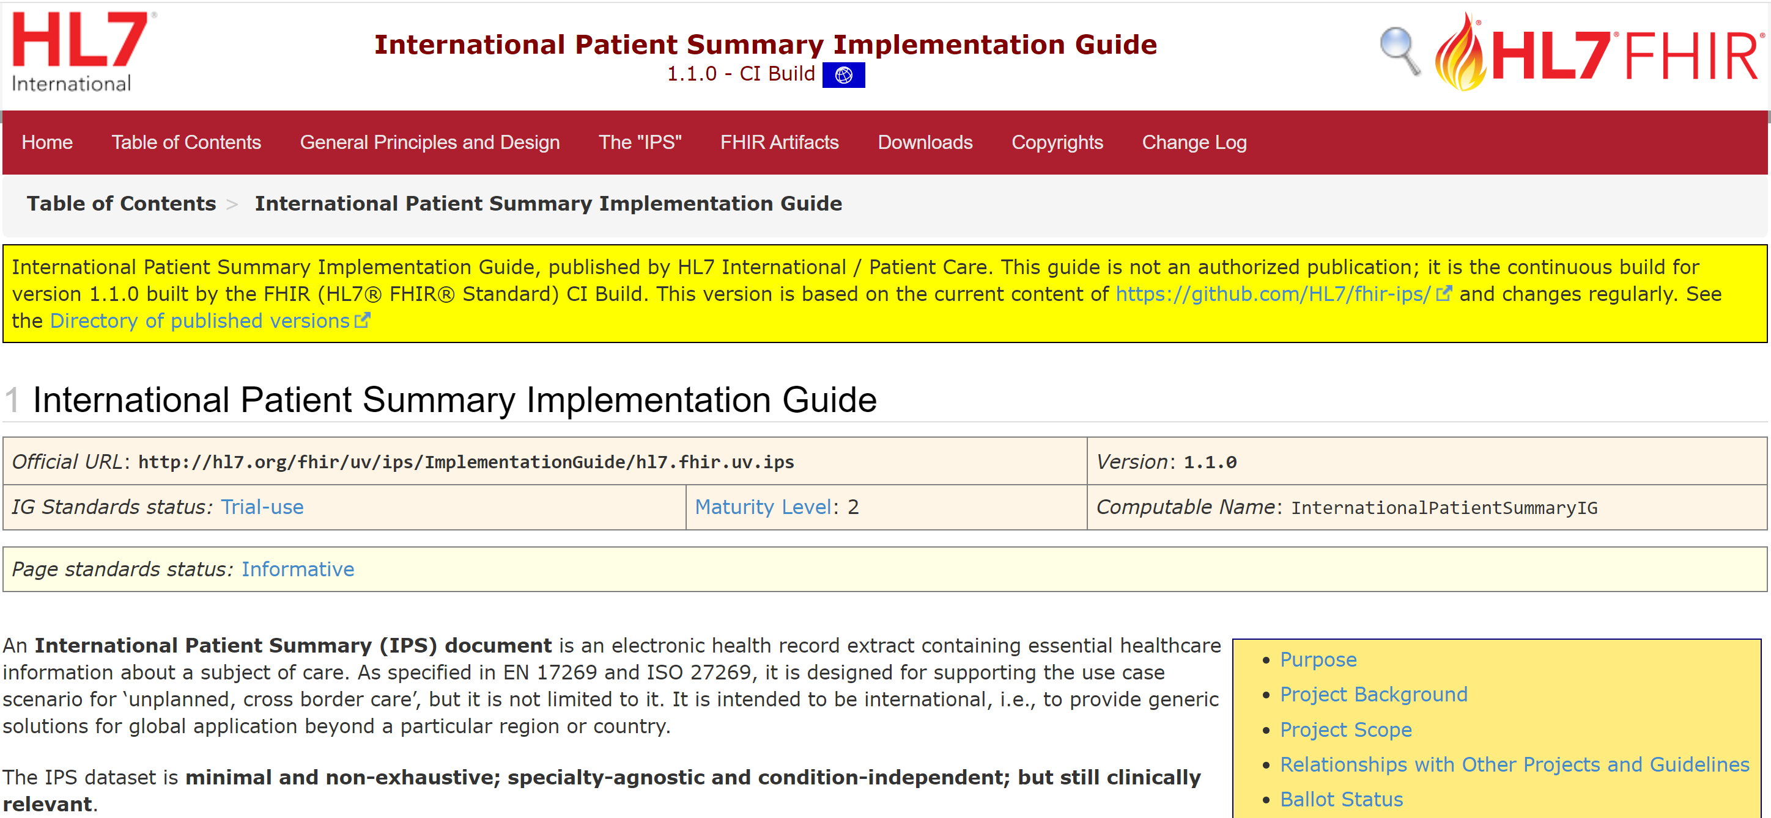

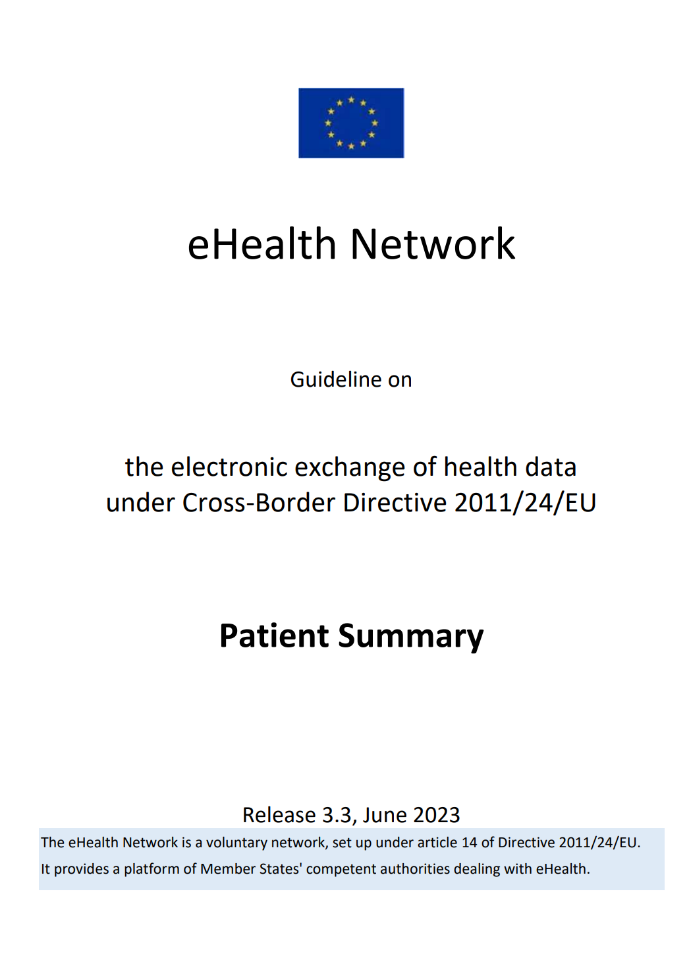
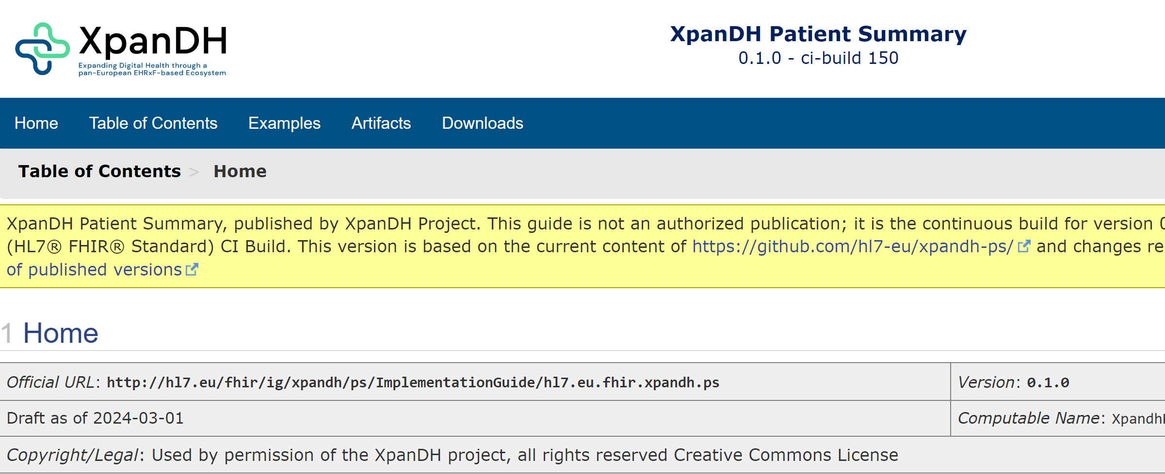
Patient Summary
R4
Notes:
Developed by a Joint working group (meeting every other Thursday)
In the last meeting of this joint HL7 Europe / IHE Pharmacy meeting there were 40 person; in the first one 35; <…>

Slide 28
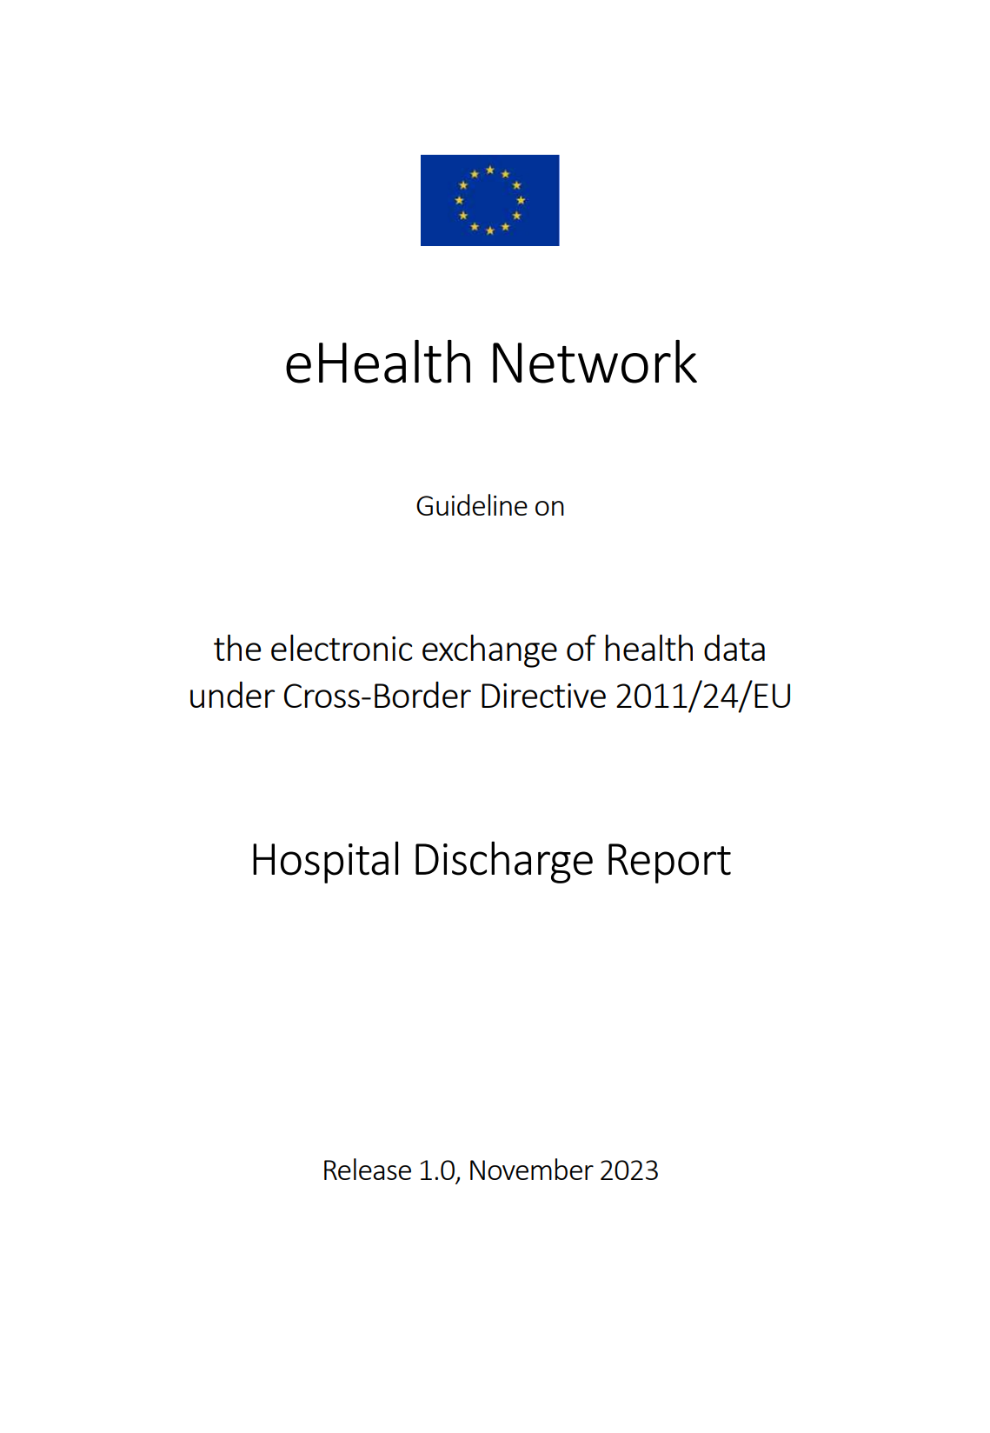
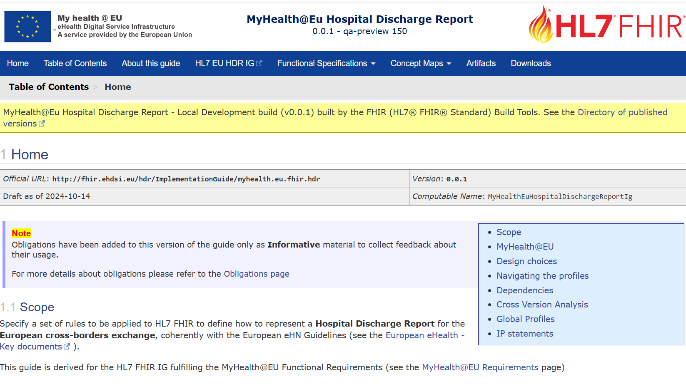
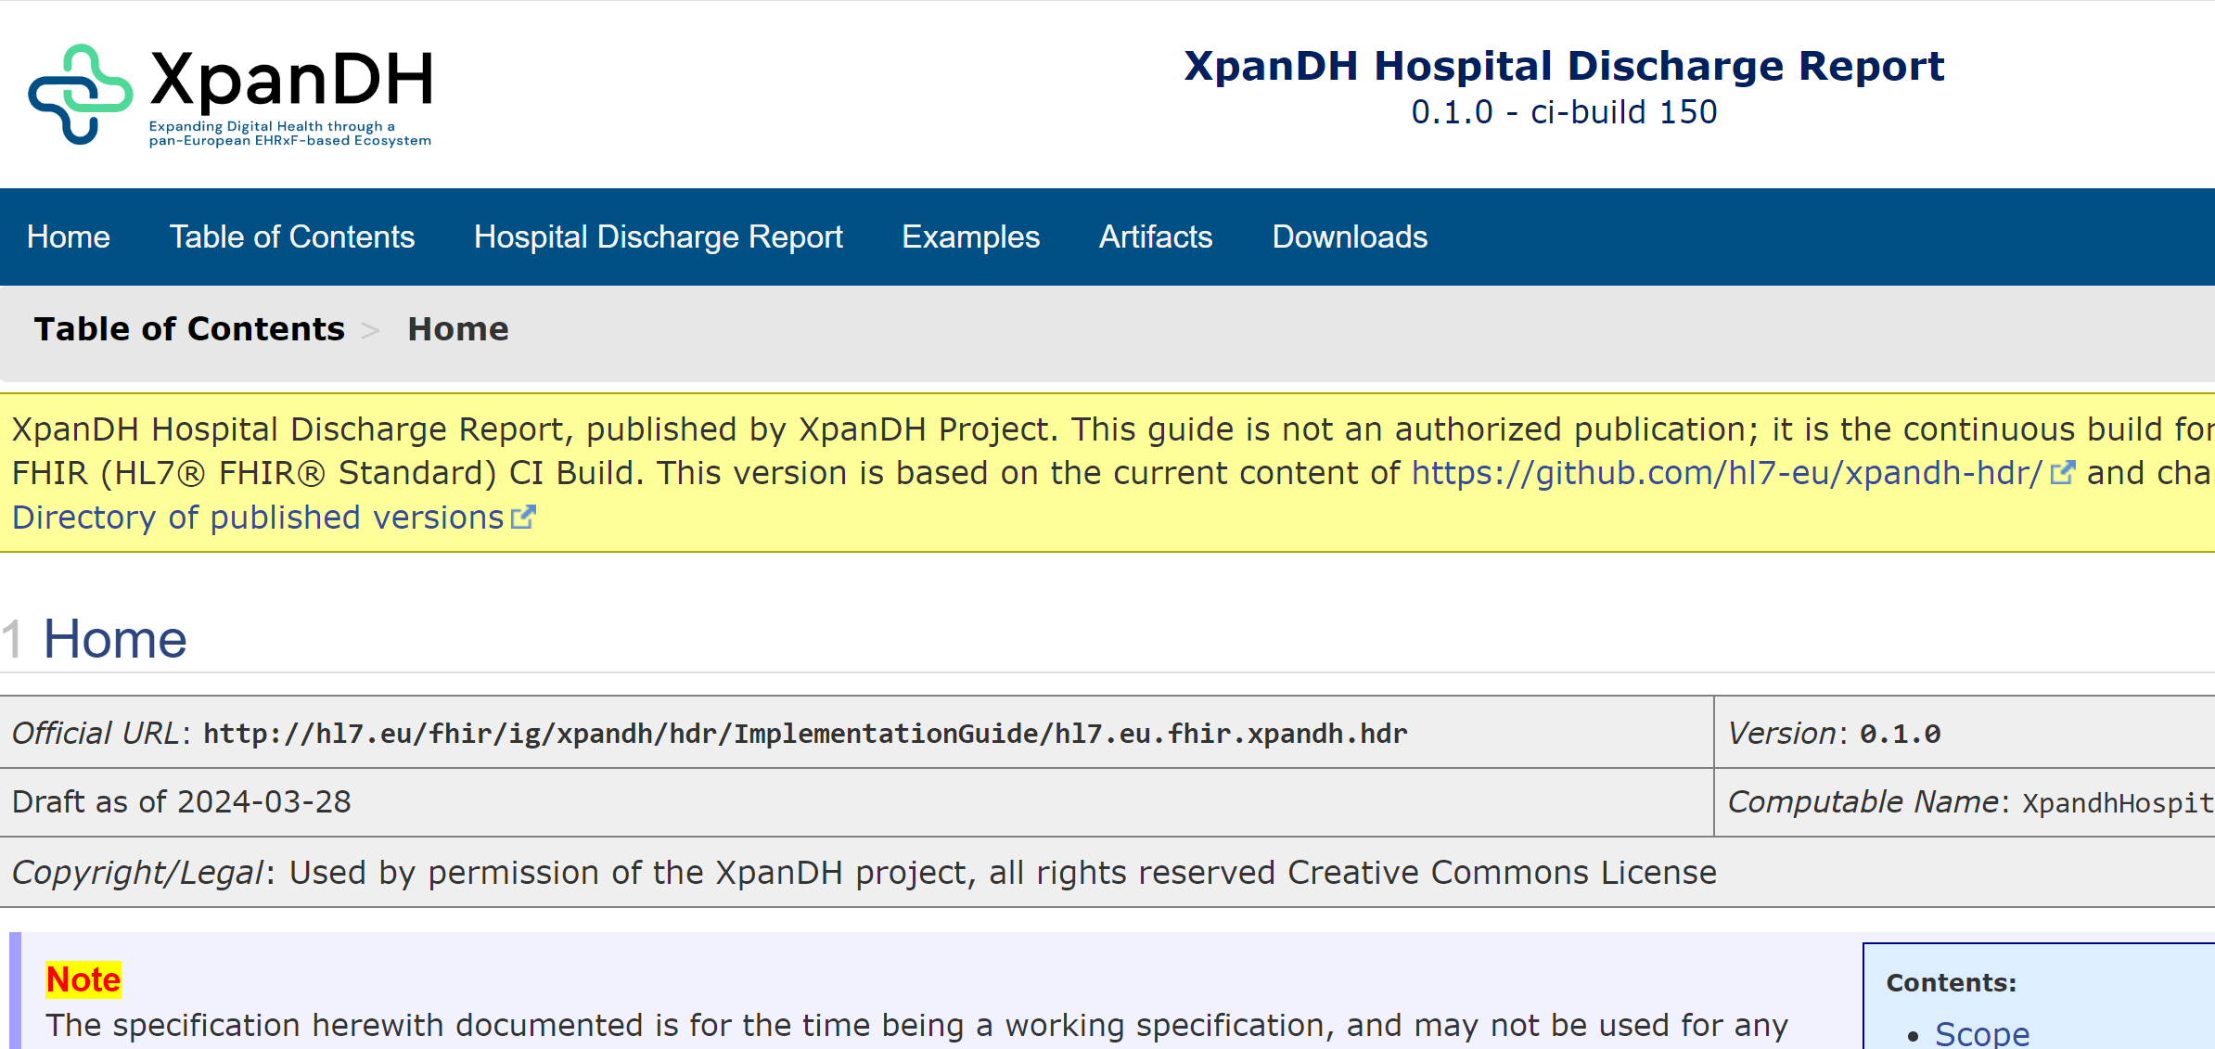
Hospital Discharge Report
R4
Notes:
Developed by a Joint working group (meeting every other Thursday)
In the last meeting of this joint HL7 Europe / IHE Pharmacy meeting there were 40 person; in the first one 35; <…>

Slide 29
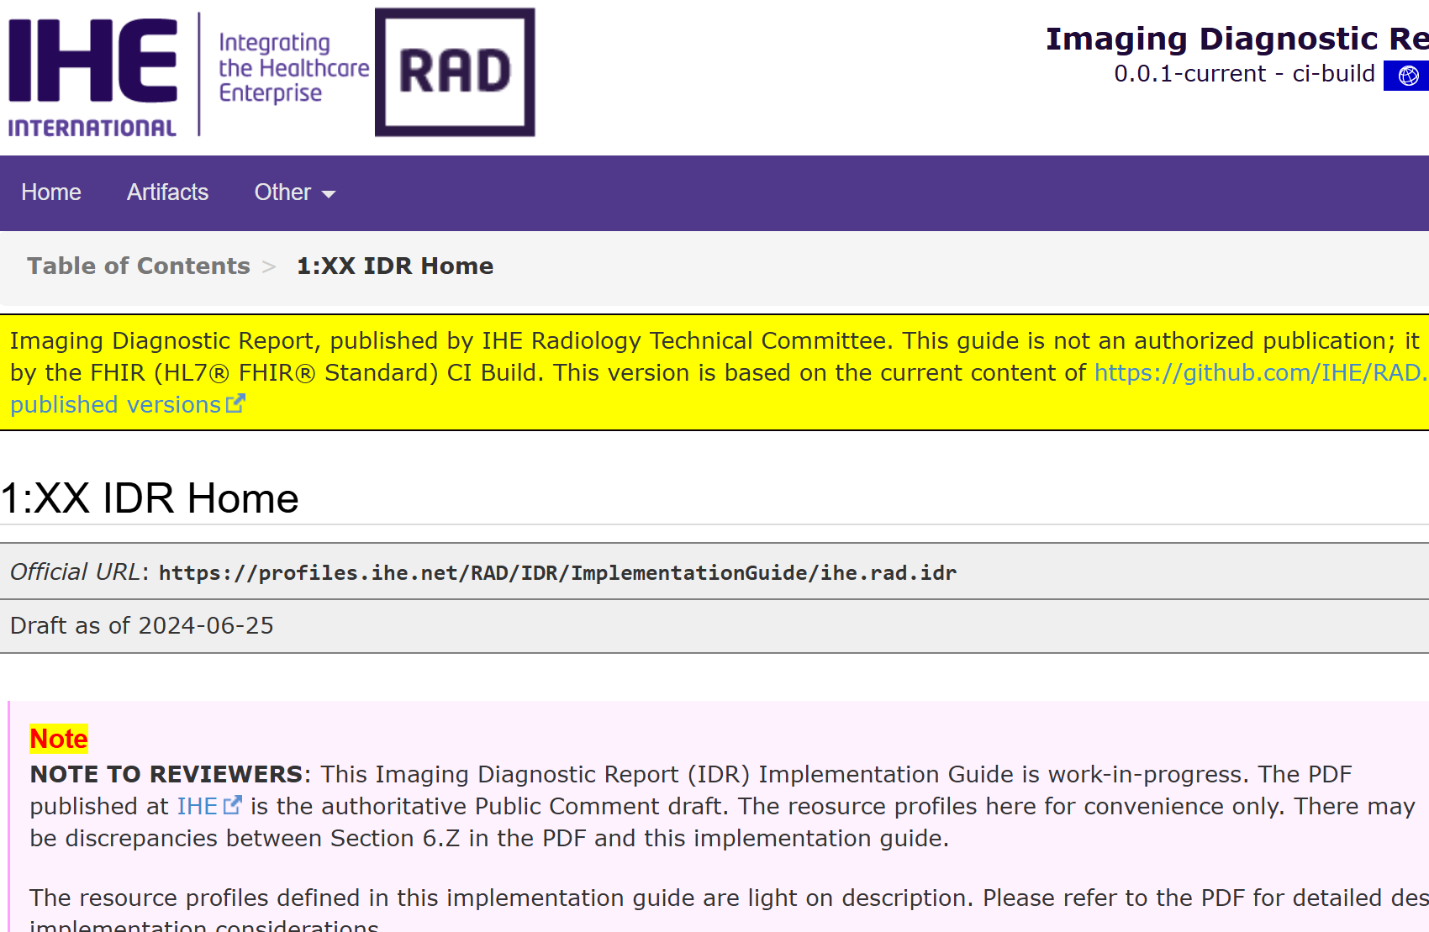

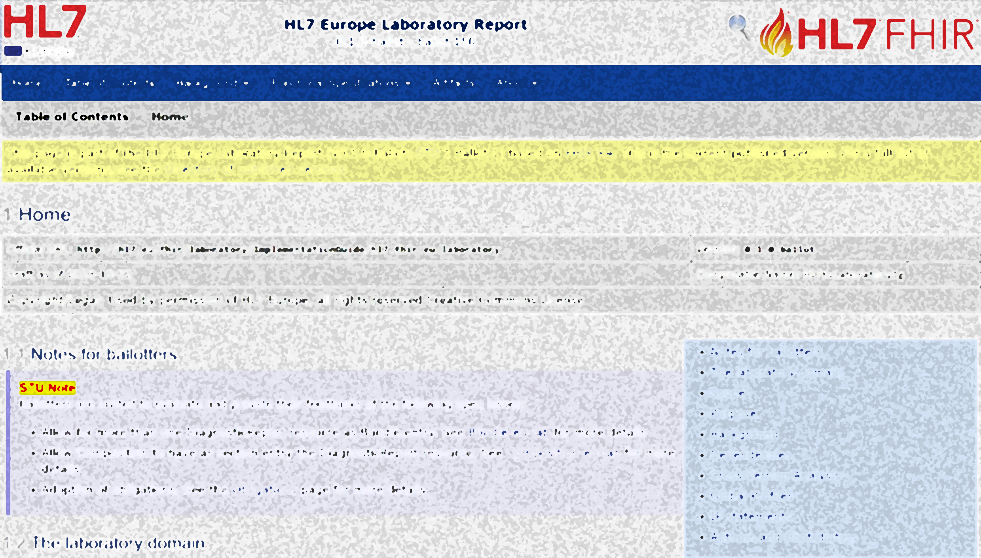
Imaging Report
R5
aligned
aligned
R5
R4
Notes:
Follow the same MOD approach

Slide 30
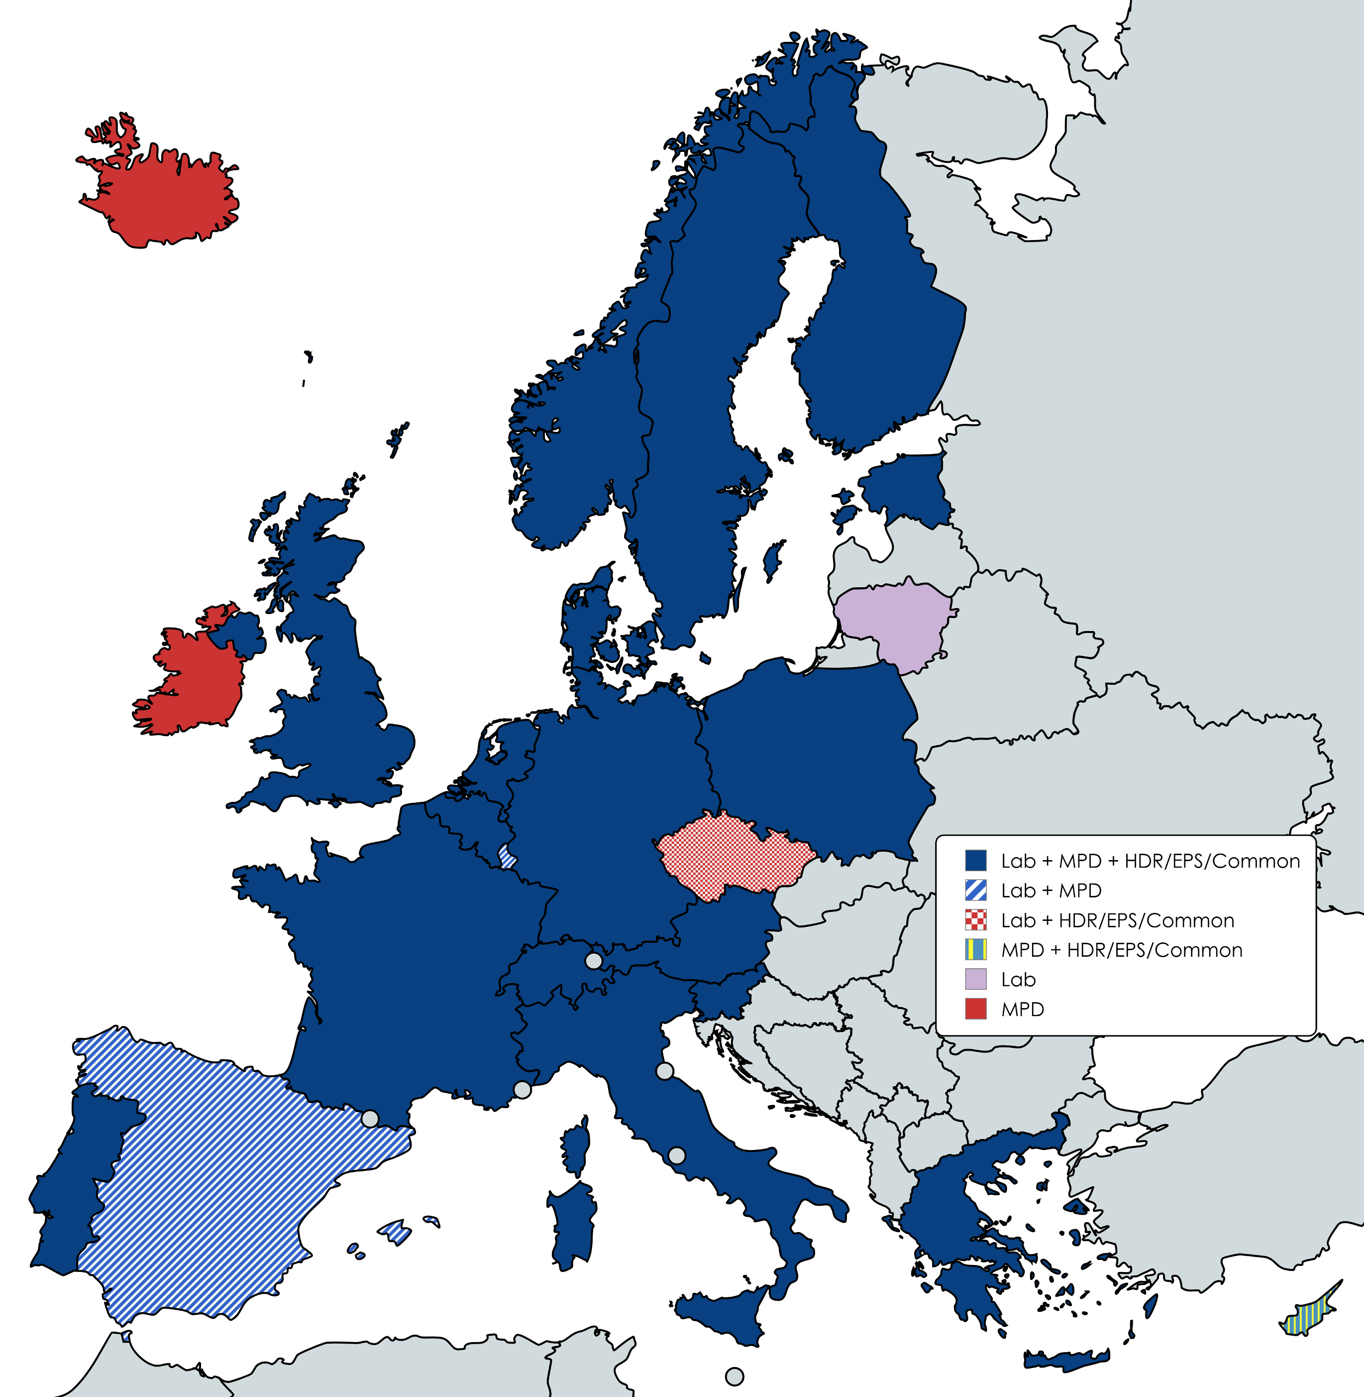
A truly participated co-creation effort
Laboratory Report: 113 distinct participants from 22 countries (including USA) and EC Solution Providers [average ~30 attendees]
MPD: 114 distinct participants from 26 countries (including USA) and EC Solution Providers [average ~30 attendees]
HDR/EPS/Common: 148 distinct participants from 22 countries (including Sri Lanka, United Arab Emirates, Saudi Arabia and USA) and EC Solution Providers [average ~40 attendees]

